Slide 1



WILEY
IFRS EDITION
Prepared by
Coby Harmon
University of California, Santa Barbara
Westmont College

Slide 2
CHAPTER
3
Adjusting the Accounts
LEARNING OBJECTIVES
After studying this chapter, you should be able to:
Explain the time period assumption.
Explain the accrual basis of accounting.
Explain the reasons for adjusting entries.
Identify the major types of adjusting entries.

Slide 3
Timing Issues
Learning Objective 1 Explain the time period assumption.
Accountants divide the economic life of a business into artificial time periods (Time Period Assumption).
. . . . .
Jan.
Feb.
Mar.
Apr.
Dec.
Generally a month, a quarter, or a year.
Also known as the “Periodicity Assumption”

Slide 4
Fiscal and Calendar Years
Monthly and quarterly time periods are called interim periods.
Most large companies must prepare both quarterly and annual financial statements.
Fiscal Year = Accounting time period that is one year in length.
Calendar Year = January 1 to December 31.

Slide 5
Fiscal and Calendar Years
Question
The time period assumption states that:
companies must wait until the calendar year is completed to prepare financial statements.
companies use the fiscal year to report financial information.
the economic life of a business can be divided into artificial time periods.
companies record information in the time period in which the events occur.

Slide 6
Accrual- versus Cash-Basis Accounting
Learning Objective 2 Explain the accrual basis of accounting.
Accrual-Basis Accounting
Transactions recorded in the periods in
which the events occur.
Companies recognize revenues when they perform services (rather than when they receive cash).
Expenses are recognized when incurred (rather than when paid).

Slide 7
Accrual- versus Cash-Basis Accounting
Cash-Basis Accounting
Revenues are recorded when cash is received.
Expenses are recorded when cash is paid.
Cash-basis accounting is not in accordance with International Financial Reporting Standards (IFRS).

Slide 8
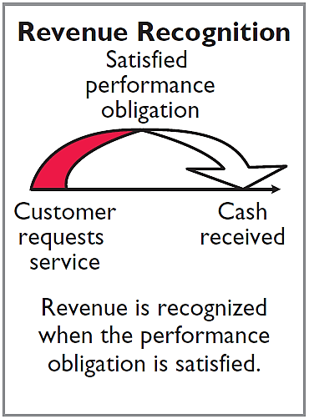
Recognizing Revenues and Expenses
REVENUE RECOGNITION PRINCIPLE
Recognize revenue in the accounting period in which the performance obligation is satisfied.

Slide 9
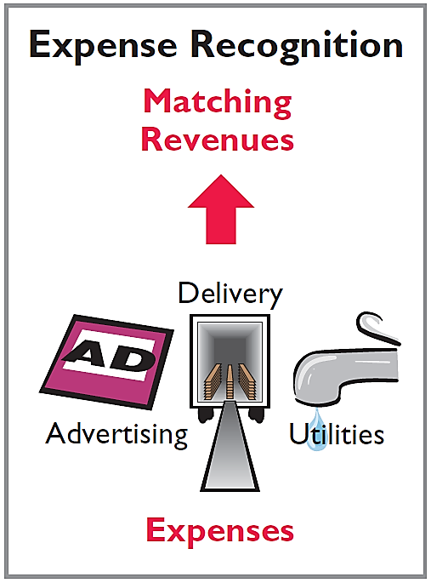
Recognizing Revenues and Expenses
EXPENSE RECOGNITION PRINCIPLE
Match expenses with revenues in the period when the company makes efforts to generate those revenues.
“Let the expenses follow the revenues.”

Slide 10
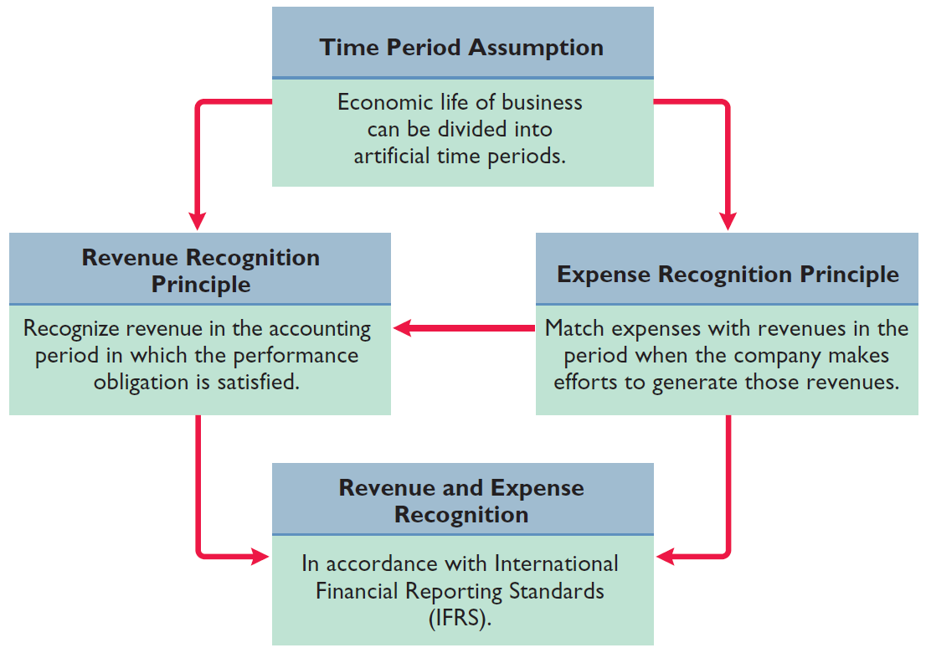
Illustration 3-1
IFRS relationships in revenue and expense recognition

Slide 11
Recognizing Revenues and Expenses
Question
The revenue recognition principle states that:
revenue should be recognized in the accounting period in which a performance obligation is satisfied.
expenses should be matched with revenues.
the economic life of a business can be divided into artificial time periods.
the fiscal year should correspond with the calendar year.

Slide 12
>
DO IT!
A list of concepts is provided in the left column below, with a description of the concept in the right column below. There are more descriptions provided than concepts. Match the description of the concept to the concept.
1. ___ Accrual-basis accounting.
2. ___ Calendar year.
3. ___ Time period assumption.
4. ___ Expense recognition principle.
f
Monthly and quarterly time periods.
Efforts (expenses) should be matched with results (revenues).
Accountants divide the economic life of a business into artificial time periods.
Companies record revenues when they receive cash and record expenses when they pay out cash.
An accounting time period that starts on January 1 and ends on December 31.
Companies record transactions in the period in which the events occur.
e
c
b

Slide 13
The Basics of Adjusting Entries
Learning Objective 3 Explain the reasons for adjusting entries.
Adjusting Entries
Ensure that the revenue recognition and
expense recognition principles are followed.
Necessary because the trial balance may not contain up-to-date and complete data.
Required every time a company prepares financial statements.
Will include one income statement account and one statement of financial position account.

Slide 14
Adjusting Entries
Question
Adjusting entries are made to ensure that:
expenses are recognized in the period in which they are incurred.
revenues are recorded in the period in which services are performed.
statement of financial position and income statement accounts have correct balances at the end of an accounting period.
All the responses above are correct.

Slide 15
Types of Adjusting Entries
Learning Objective 4 Identify the major types of adjusting entries.
Deferrals
Accruals
1. Prepaid Expenses. Expenses paid in cash before they are used or consumed.
1. Accrued Revenues. Revenues for services performed but not yet received in cash or recorded.
2. Unearned Revenues.
Cash received before services are performed.
2. Accrued Expenses. Expenses incurred but not yet paid in cash or recorded.
Illustration 3-2
Categories of adjusting entries

Slide 16
QUESTION

Slide 17
THANK YOU SO MUCH
MAY ALMIGHTY ALLAH SAVE ALL OF US

Slide 18
HOME WORK : Solve the following Problem
P3-3A (Page No. Book-149, Pdf 167, Financial Accounting IFRS 3e)

